Slide 2
Session -1

Slide 3
What is Java?
Java is a general-purpose, class-based, high-level and object-oriented programming language that was initially developed by Sun Microsystems (now a subsidiary of Oracle) in 1995.
It follows the principle of WORA (Write Once Run Anywhere) – you can run a java program as many times as you want on a Java supported platform after it is compiled.
There is no need for recompilation.
A platform is any hardware or software environment where you can run your programs. Java is known as a platform because it has a runtime environment (JRE) and API.

Slide 4
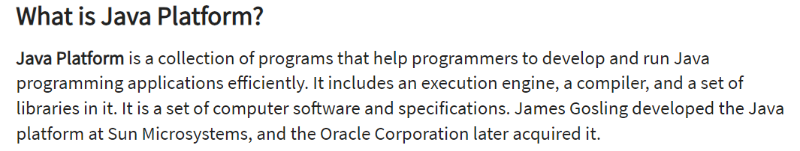
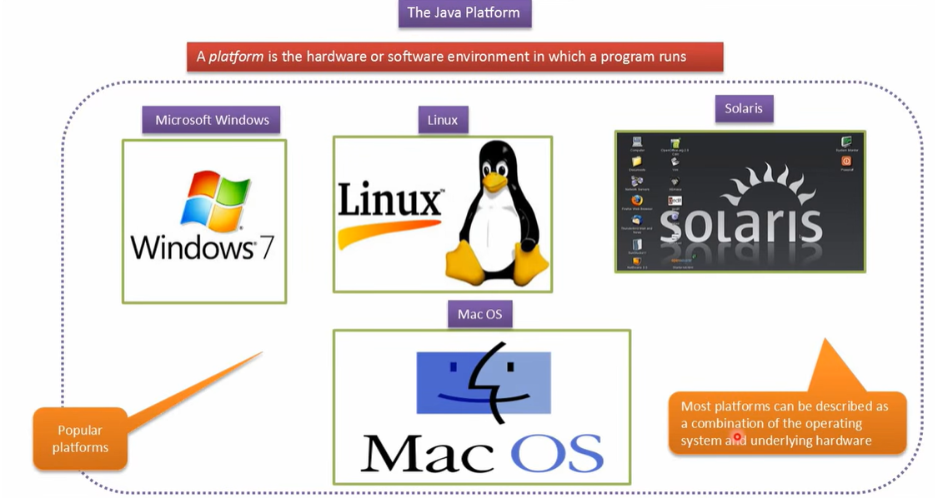

Slide 5
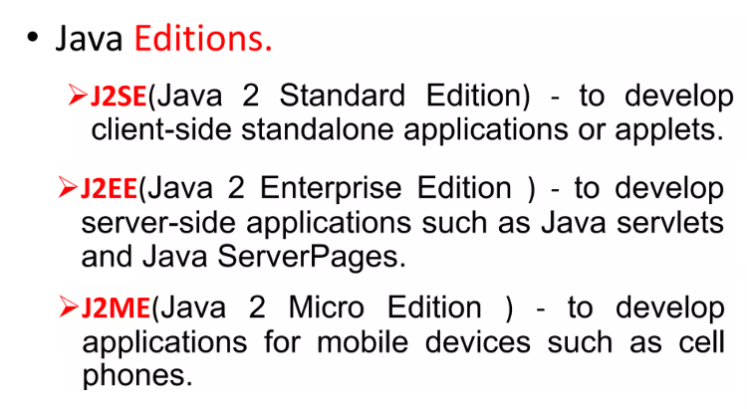

Slide 6
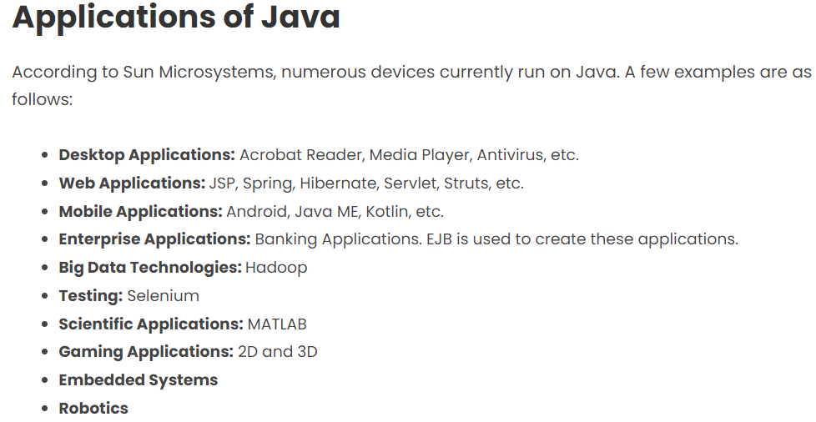

Slide 7
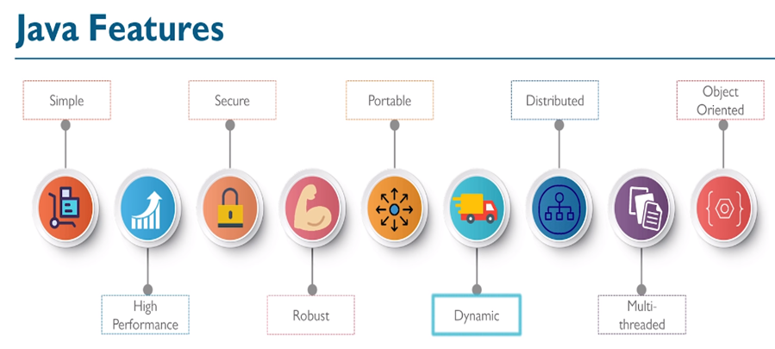

Slide 8
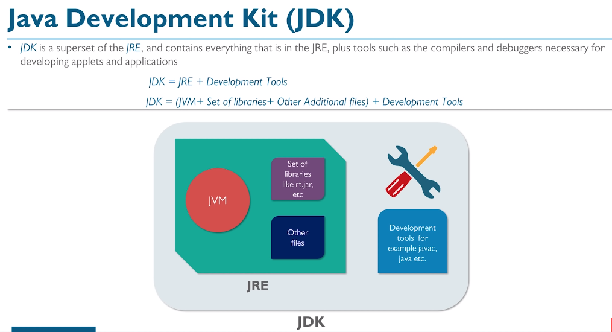

Slide 9
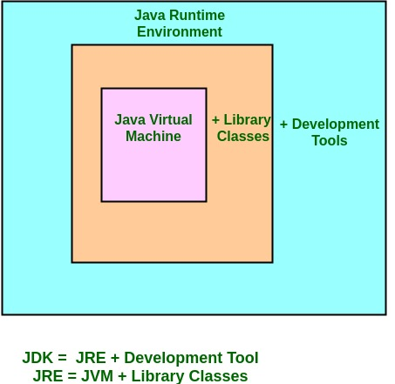
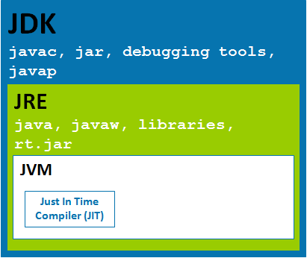

Slide 10
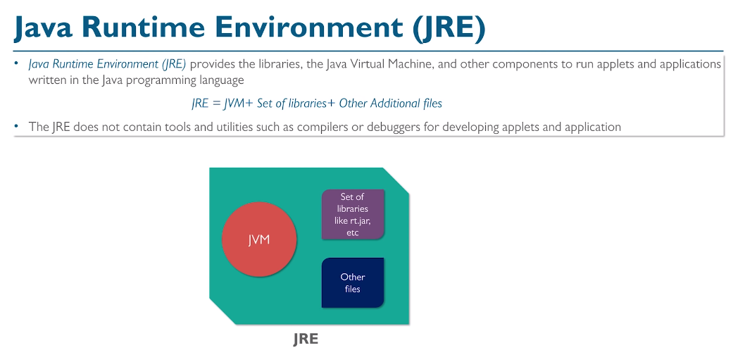

Slide 11
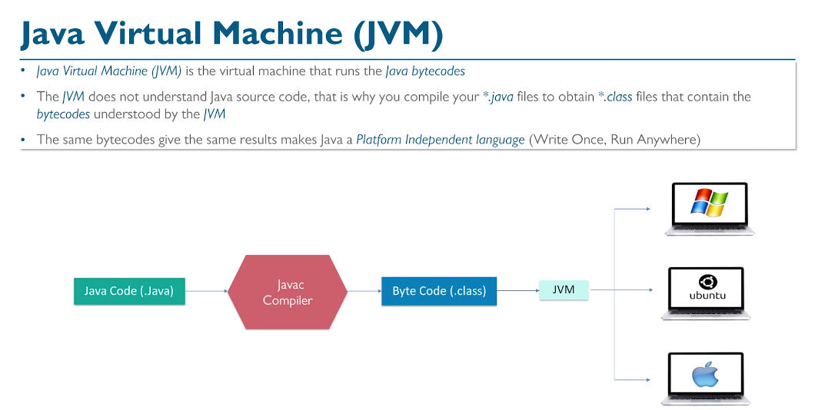

Slide 12
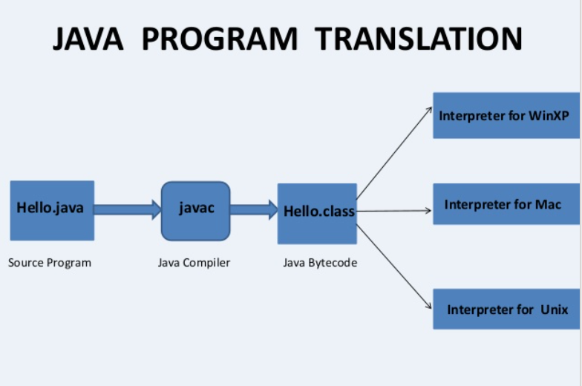

Slide 13
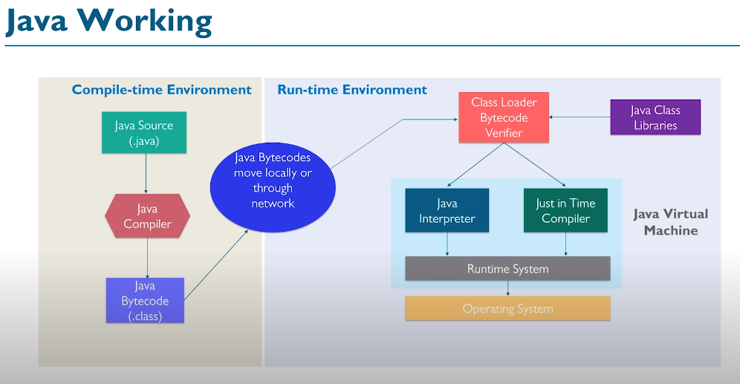

Slide 14
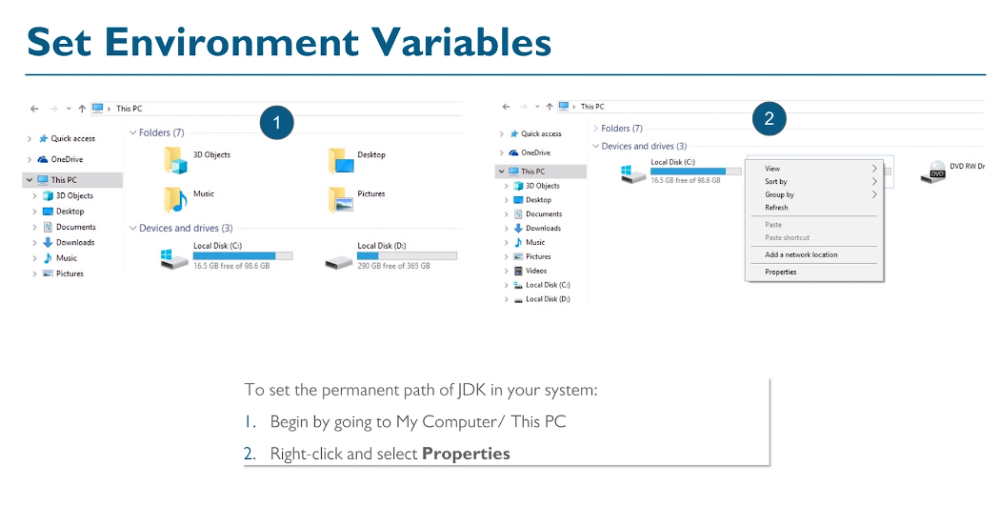

Slide 15


Slide 16
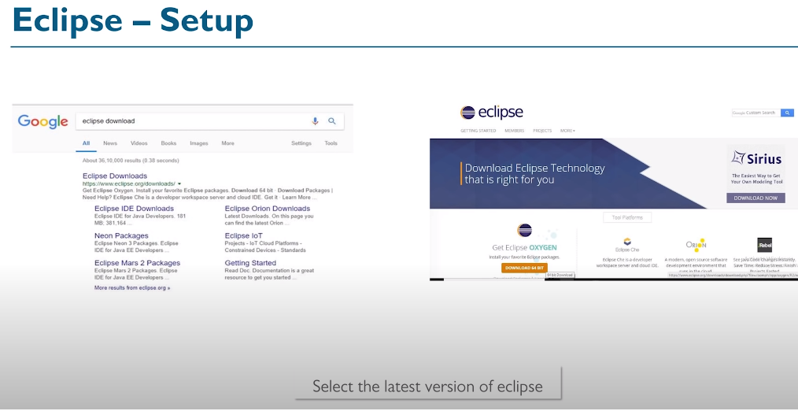

Slide 17
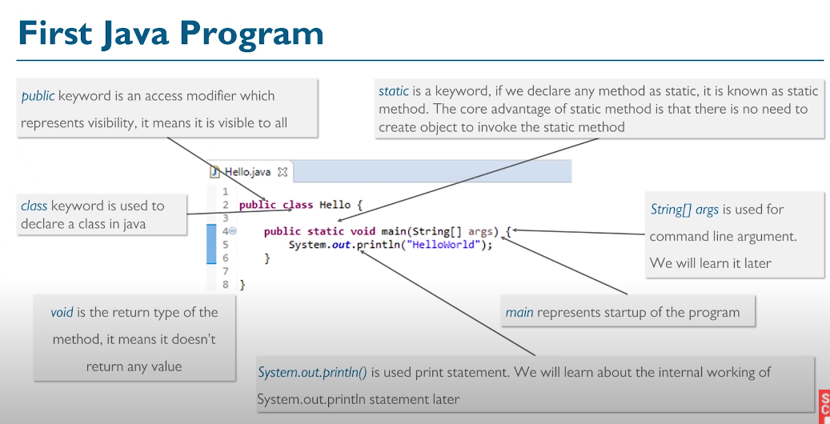

Slide 18
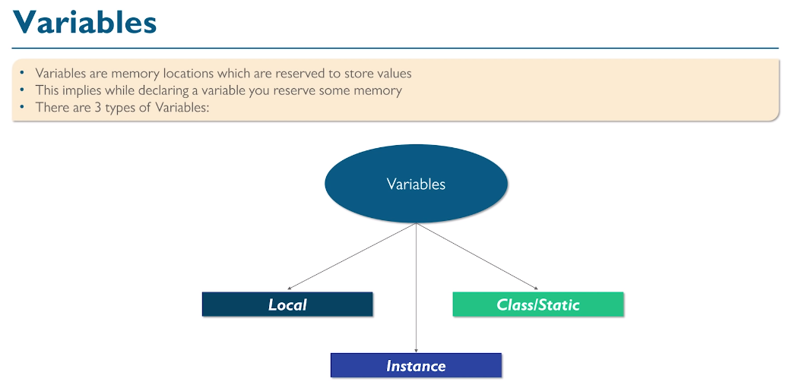

Slide 19
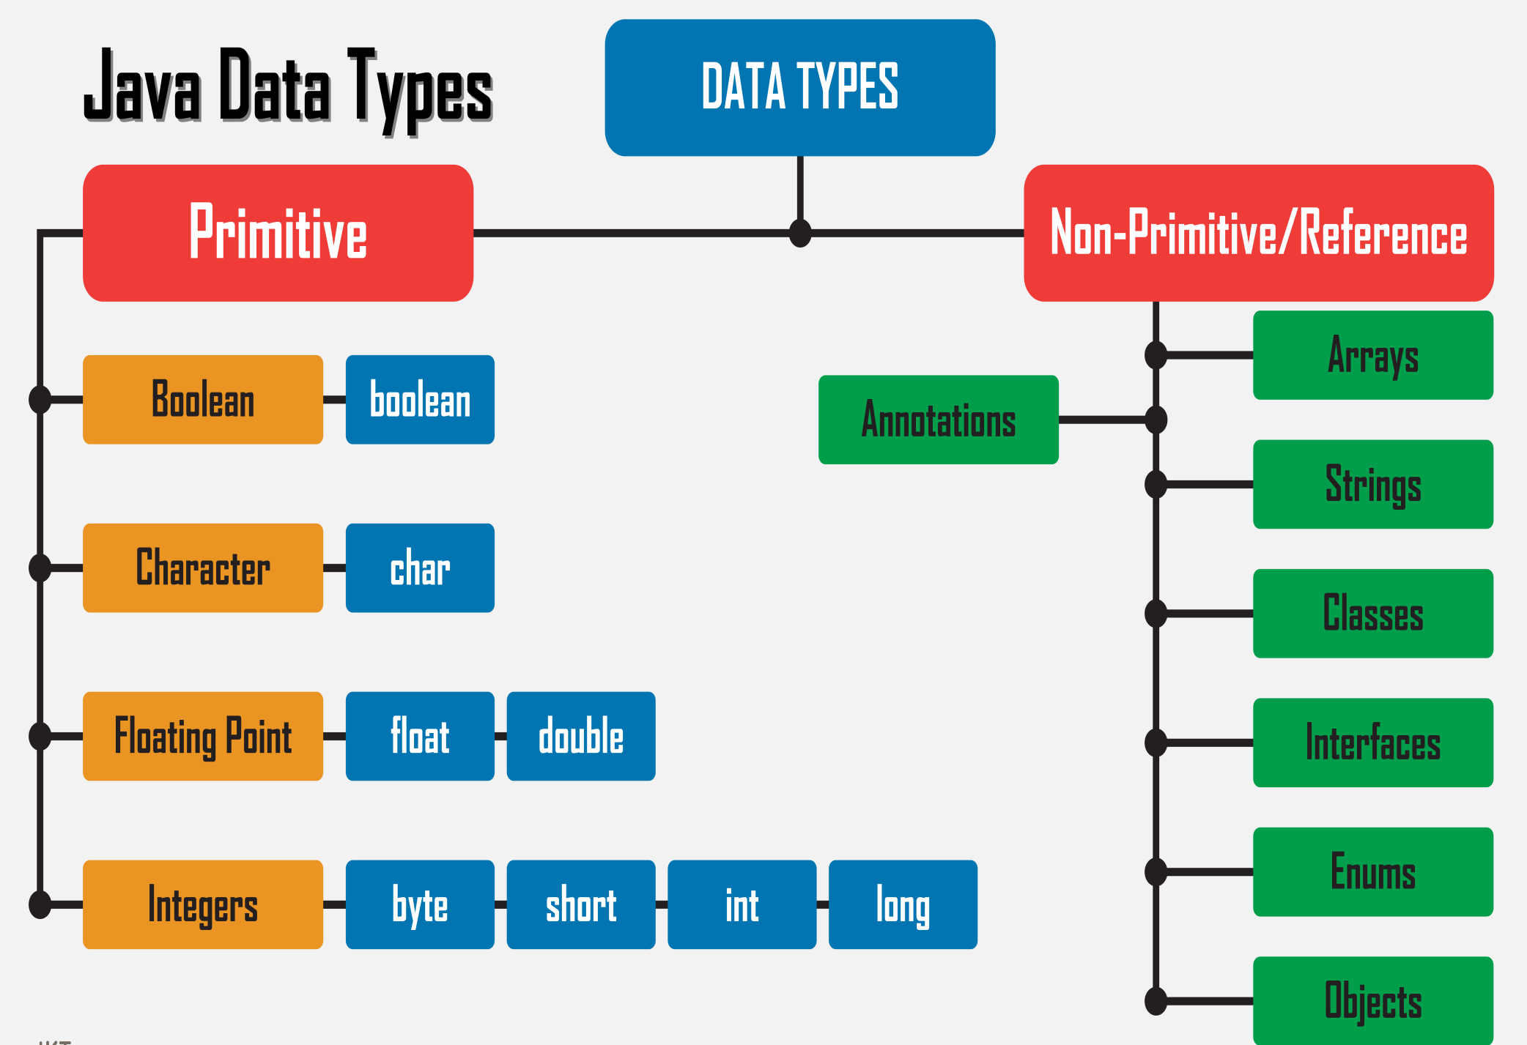

Slide 20
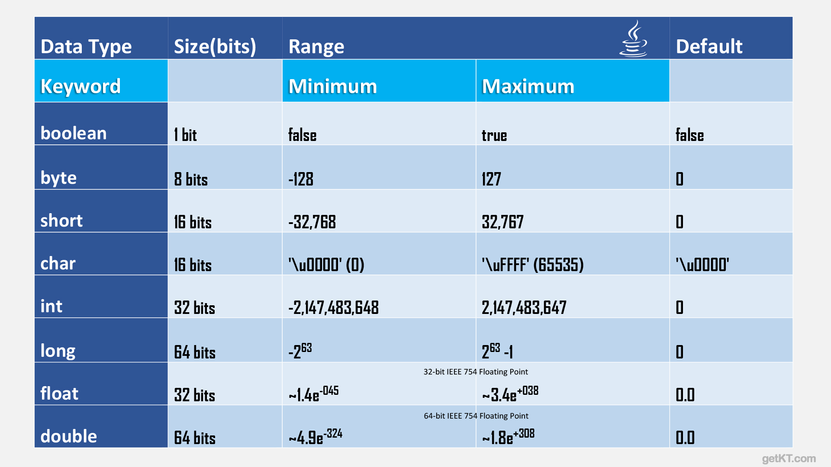

Slide 21
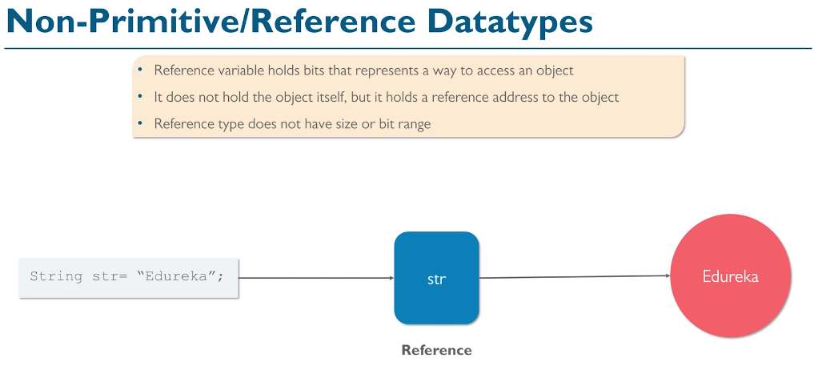

Slide 22
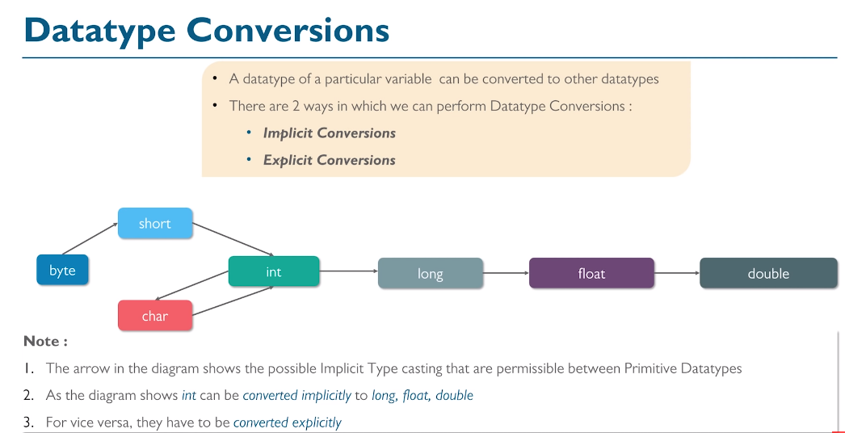

Slide 23
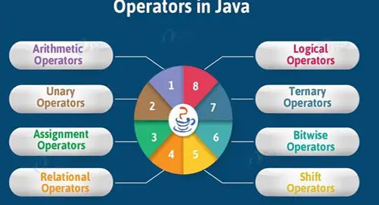

Slide 24
There as many types of Operators in Java as follows:
Arithmetic Operator
Assignment Operator
Relational Operator
Logical Operator
Bitwise Operator
Unary Operator
Shift Operator
Ternary Operator

Slide 25
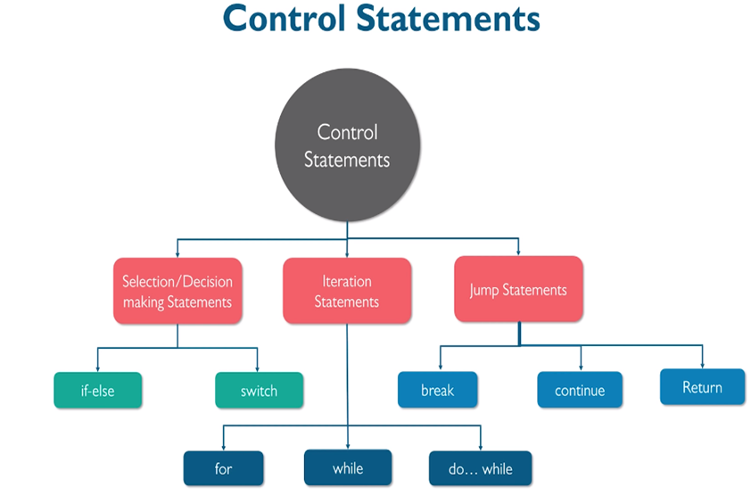

Slide 26
Session 2
Array
OOPS Concept
Encapsulation
Abstraction
Inheritance
Polymorphism
Abstract class & Interfaces

Slide 27
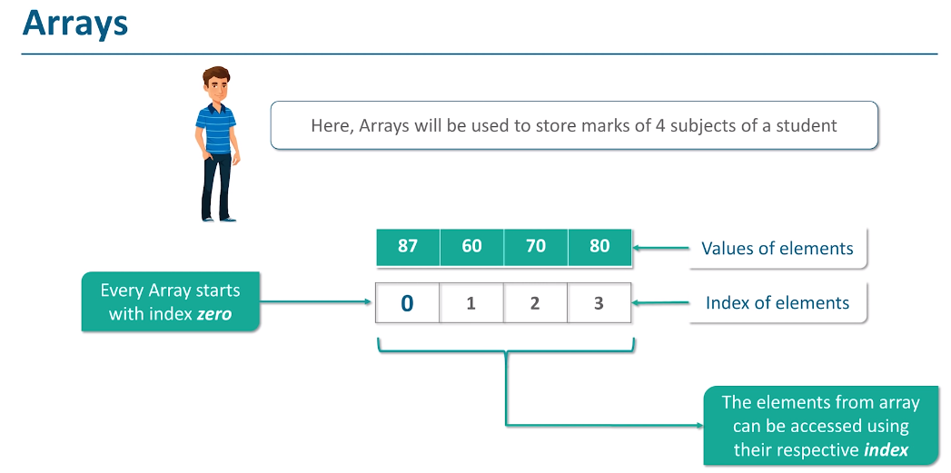
Arrays are fundamental structures in Java that allow us to store multiple values of the same type in a single variable.

Slide 28
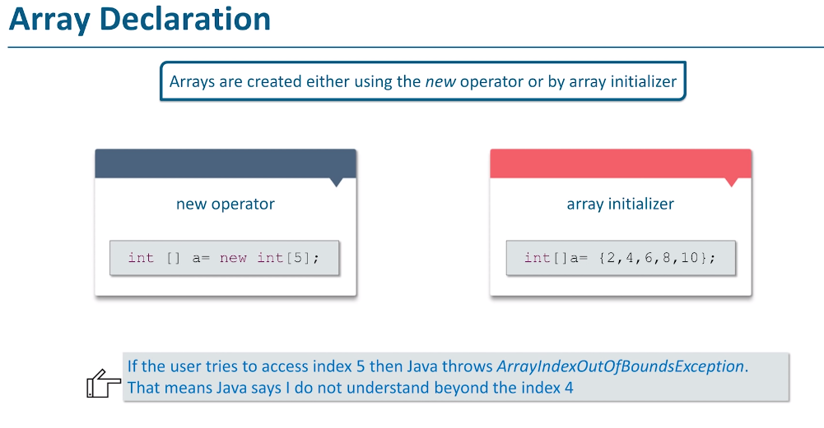

Slide 29
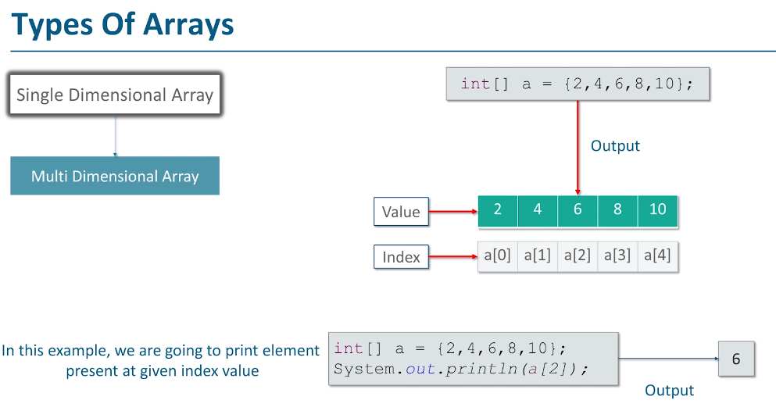

Slide 30
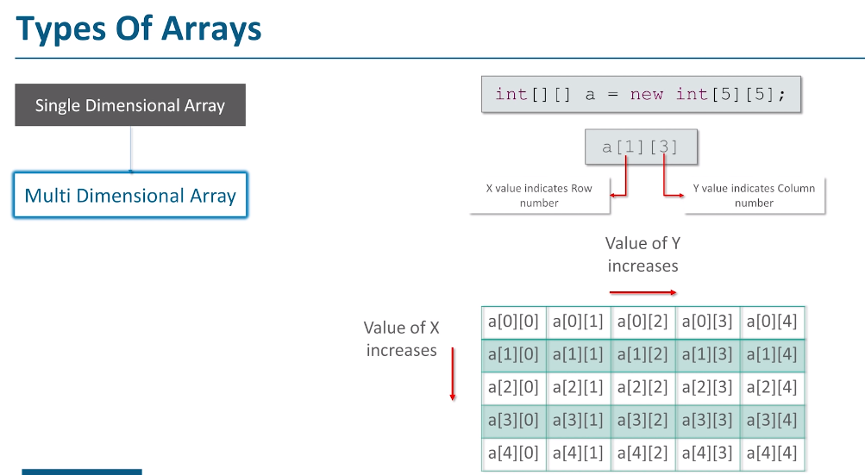

Slide 31
Object-oriented programming (OOP) in Java is a programming methodology or paradigm (model) to design a computer program using classes and objects.
It is the most popular programming paradigm and widely used in the software industry today. It is an extension of procedural programming.
Procedural programming means writing code without objects. Whereas, object-oriented programming means writing code with objects. It contains data in the form of fields or variables (often known as attributes or properties in java) and functionality code in the form of methods (often known as behavior in java).

Slide 32
What is an Object
Characteristics of an object in JavaAn object has three characteristics:
1. State: State represents properties of an object. It is represented by instance variable/attribute of an object. The properties of an object are important because the outcome of functions depend on the properties.
2. Behavior: Behavior represents functionality or actions. It is represented by methods in Java.
3. Identity: Identity represents the unique name of an object. It differentiates one object from the other. The unique name of an object is used to identify the object.

Slide 33
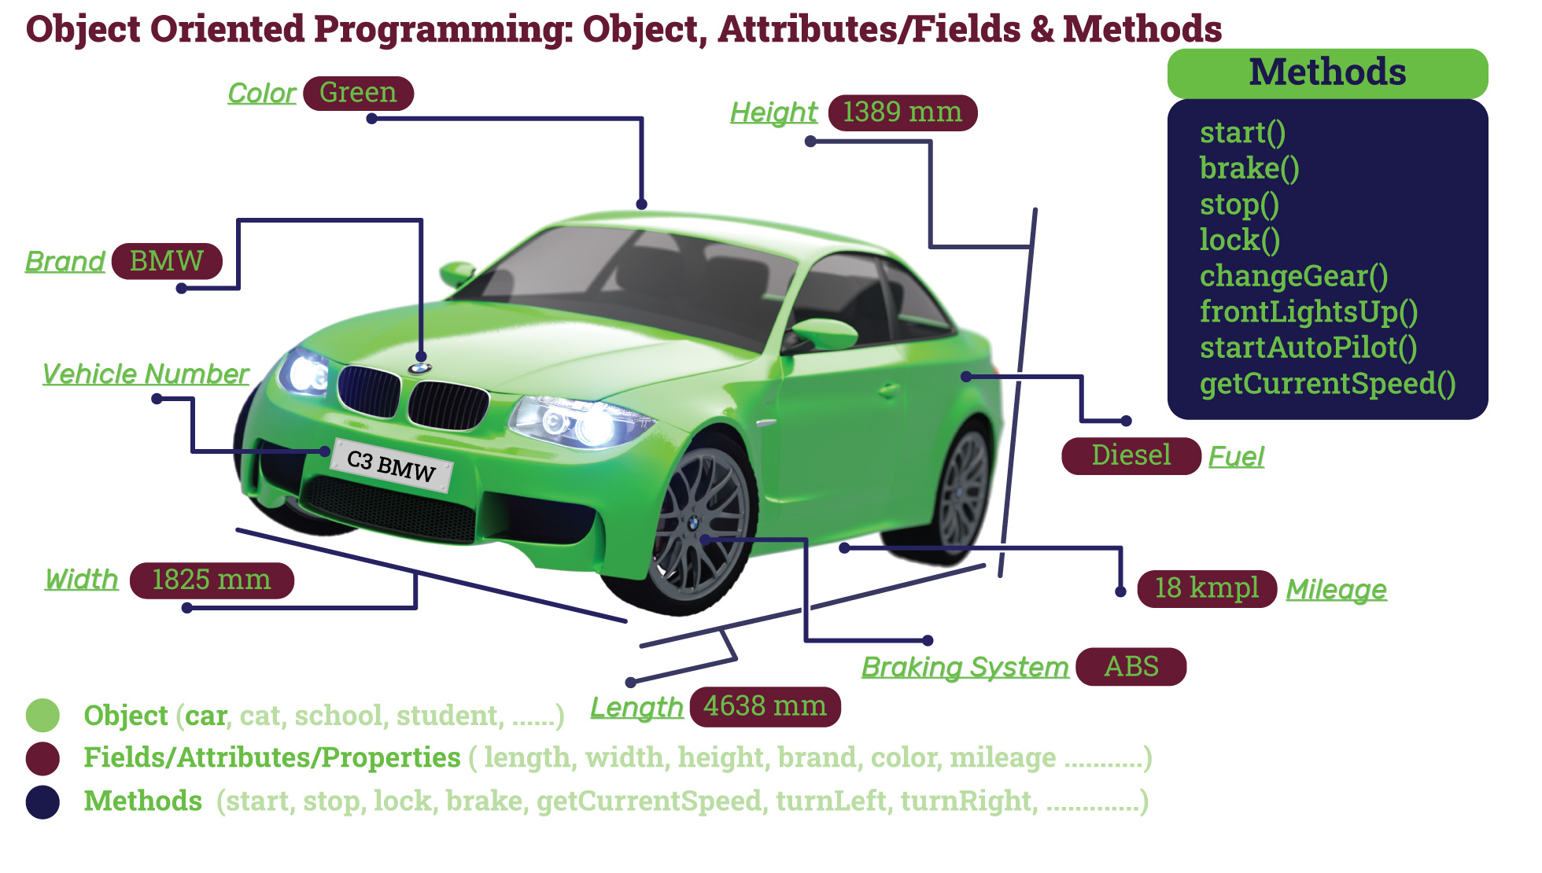
Following image illustrates, as if car is a object what are it’s fields and methods

Slide 34
1. Modifiers: A class can be either public or default access modifier. But the members of class can be public, private, default, and protected. All these are the access modifiers.
2. Class name: By convention, a class name should begin with a capital letter and subsequent characters lowercased (for example Student). If a name consists of multiple words, the first letter of each word should be uppercased ( for example CollegerStudent).
A class name can also start with an underscore ”_”. The following class name can be valid such as _, _Student. Keywords cannot be a valid class name. For example, class, true, null, etc are not accepted as a class name.
3. Body: Every class’s body is enclosed in a pair of left and right braces. In the body, a class can contain the following members.

Slide 35
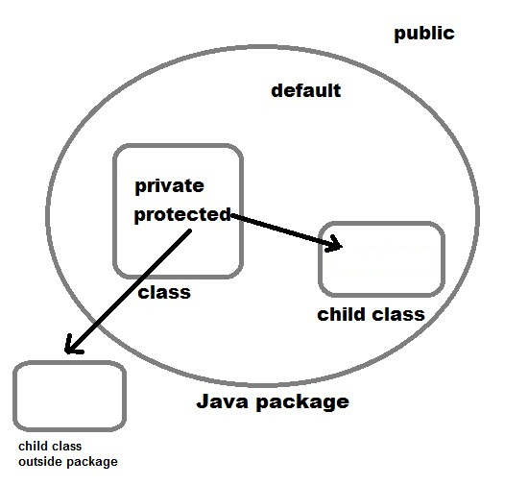
Access Modifiers in Java
Access modifiers are keywords in Java that are used to set accessibility. An access modifier restricts the access of a class, constructor, data member and method in another class.
Java language has four access modifier to control access level for classes and its members.
Default: Default has scope only inside the same package
Public: Public has scope that is visible everywhere
Protected: Protected has scope within the package and all sub classes
Private: Private has scope only within the classes
Java also supports many non-access modifiers,
such as static, abstract,
synchronized, native,
volatile, transient etc.

Slide 36
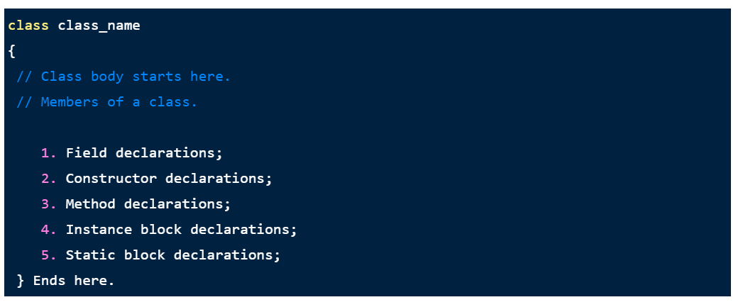

Slide 37
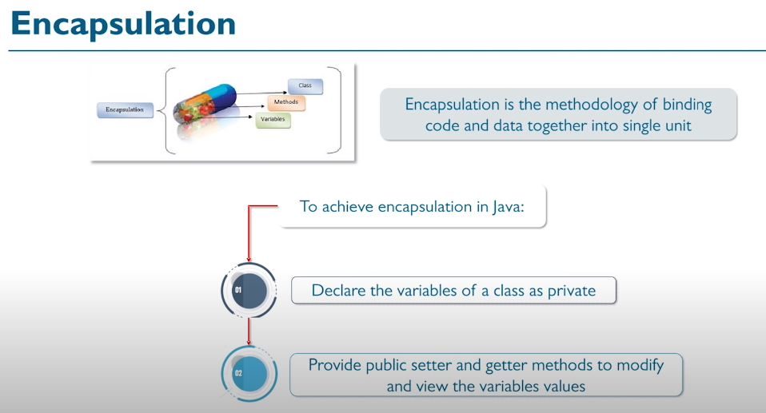

Slide 38
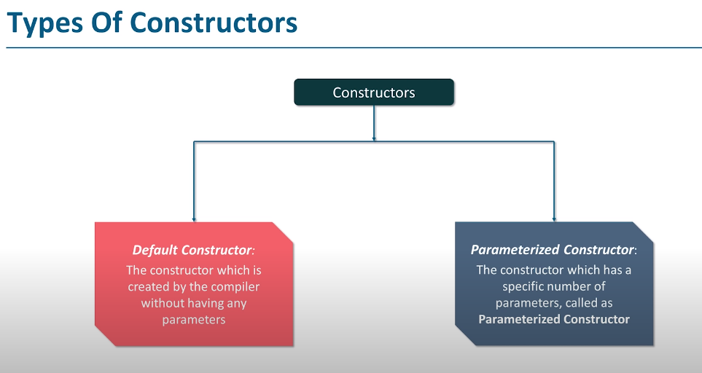

Slide 39
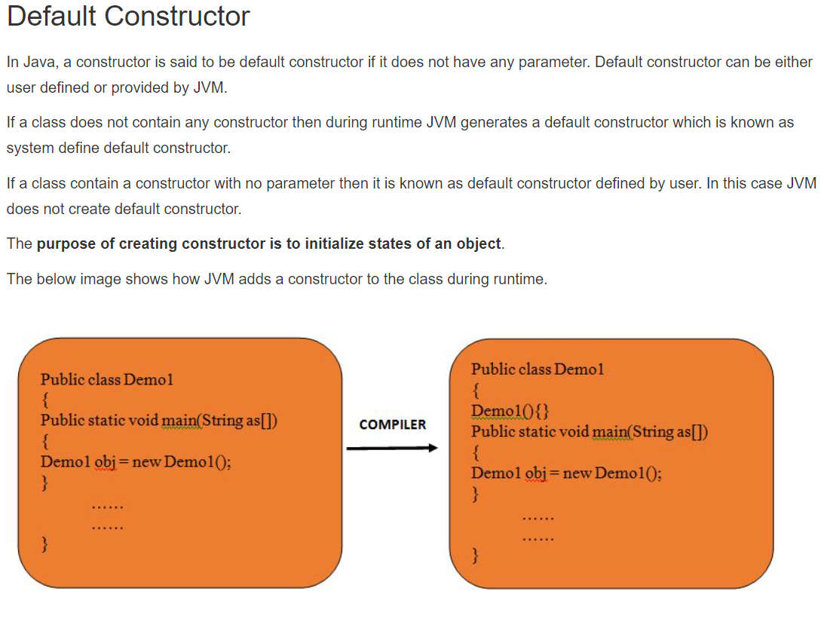

Slide 40
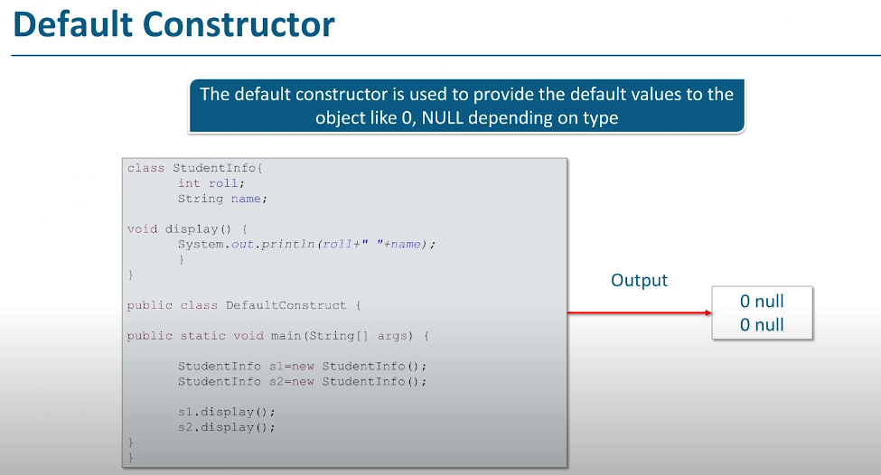

Slide 41
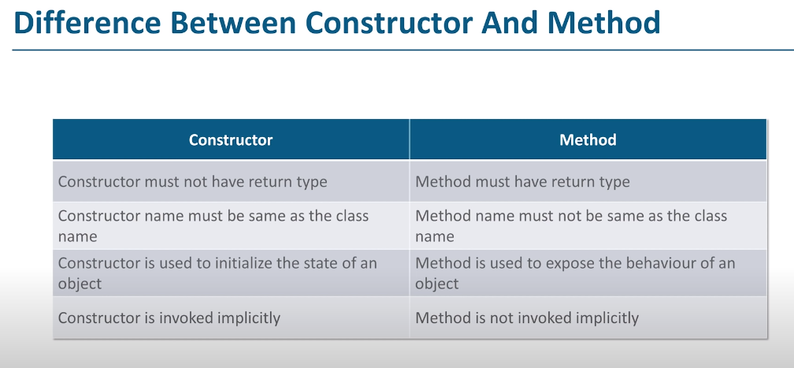

Slide 42
Static keyword
The static keyword in Java is mainly used for memory management.
The static keyword in Java is used to share the same variable or method of a given class.
Static Variables
when we create objects of a class, then every object will have its own copy of all the variables of the class
Static Methods
Static methods are also called class methods. It is because a static method belongs to the class rather than the object of a class.

Slide 43
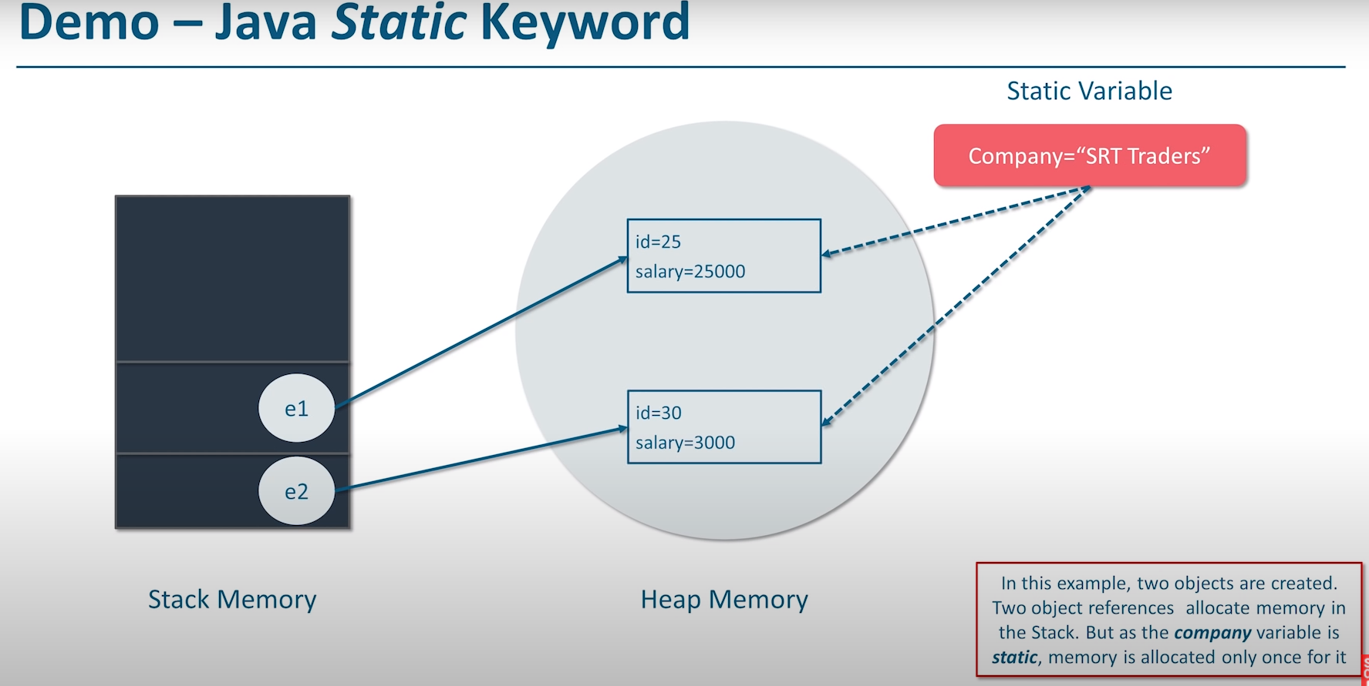

Slide 44
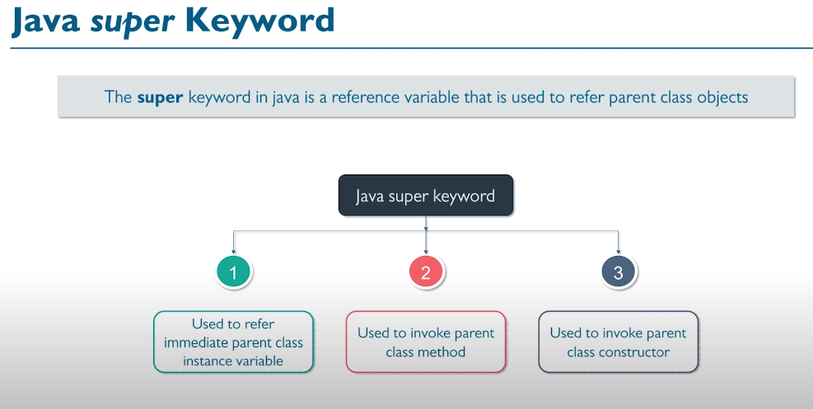

Slide 45
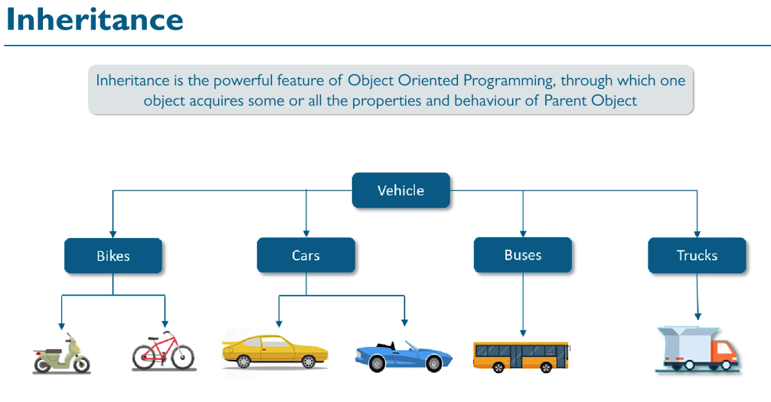
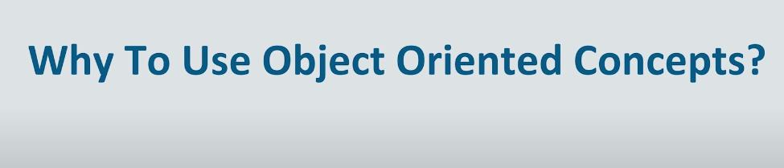

Slide 46
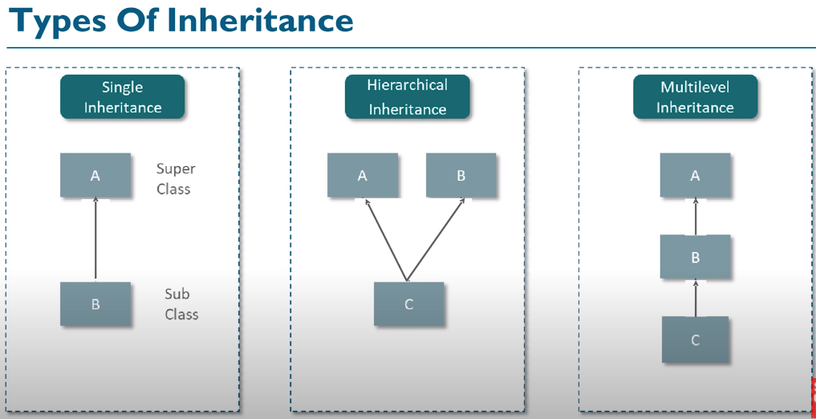

Slide 47
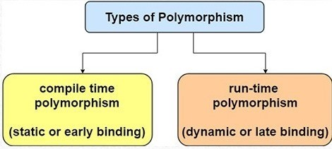
Polymorphism in OOPS concept that means one can perform a single action by various ways, actually poly means many and morph means forms, these both words are Greek words.
There are two types in polymorphism, one is compile time polymorphism and the second one is runtime polymorphism.
By using method overloading and method overriding developer can perform polymorphism.

Slide 48
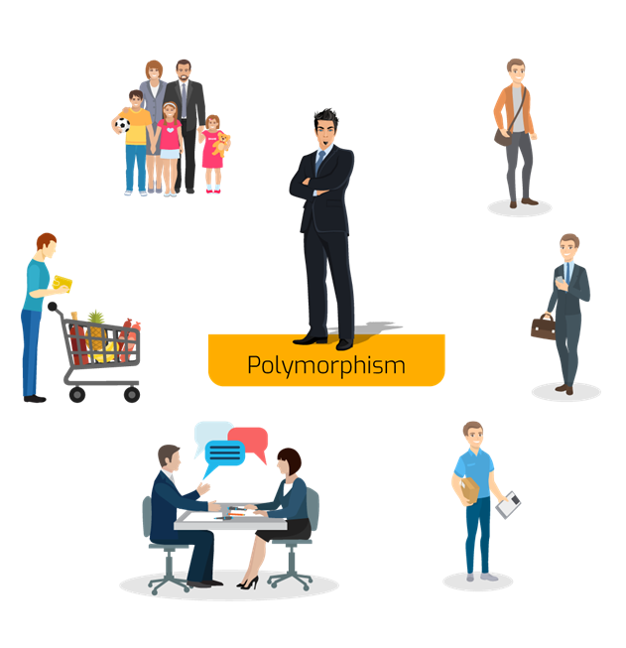

Slide 49
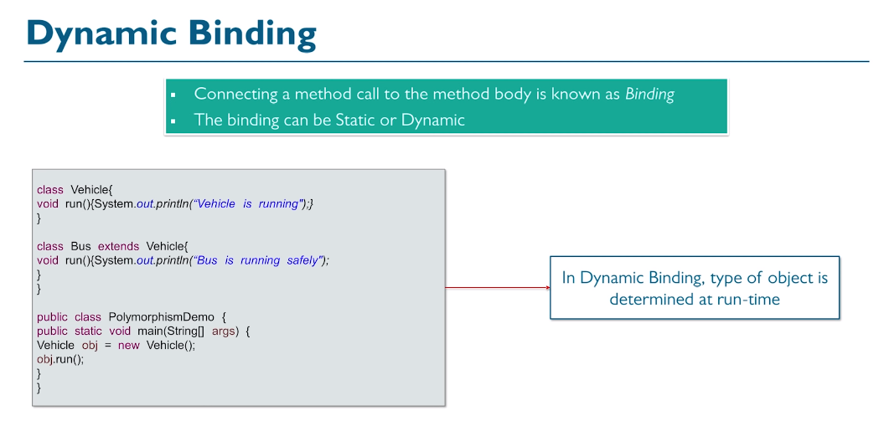

Slide 50
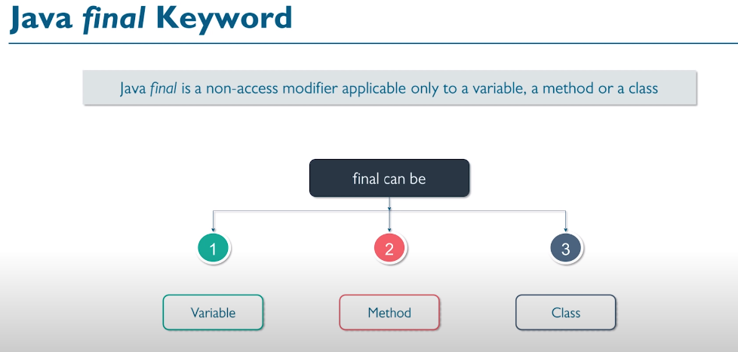
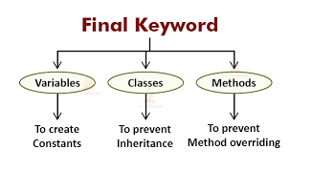

Slide 51
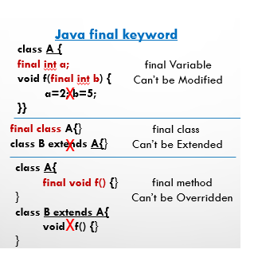

Slide 53
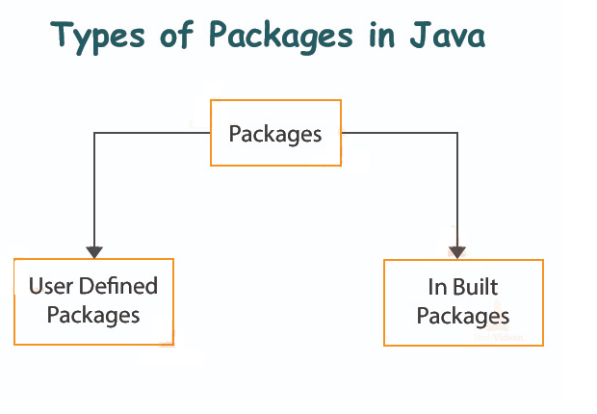
Package in Java
A package is nothing but a physical folder structure (directories) that contains a group of related classes, interfaces, and sub-packages according to their functionality. It provides a convenient way to organize your work.
A real-life example is when you download a movie, song, or game, you make a different folder for each category like movie, song, etc. In the same way, a group of packages in java is just like a library.
The classes and interfaces of a package are like books in the library that can reuse several times when we need. This reusability nature of packages makes programming easy.

Slide 54
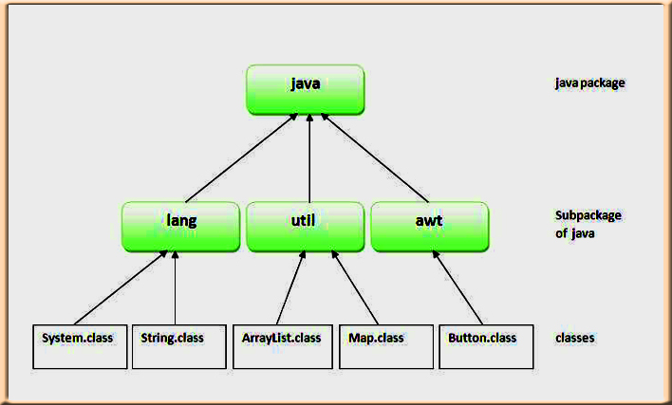
Predefined Packages in Java (Built-in Packages)
Predefined packages in java are those which are developed by Sun Microsystem. They are also called built-in packages in java. These packages consist of a large number of predefined classes, interfaces, and methods that are used by the programmer to perform any task in his programs.

Slide 55
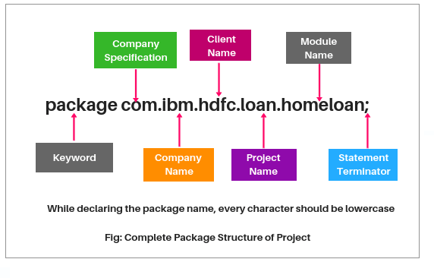
Naming Convention to declare User-defined Package in Real-time Project
While developing your project, you must follow some naming convention regarding packages declaration. Let’s take an example to understand the convention. See below a complete package structure of the project.

Slide 56
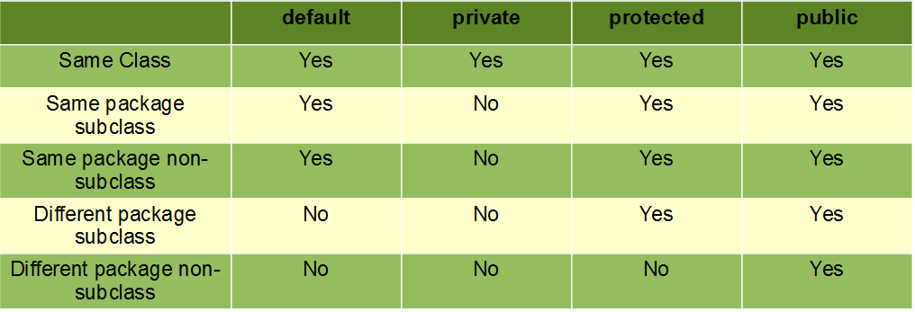

Slide 57
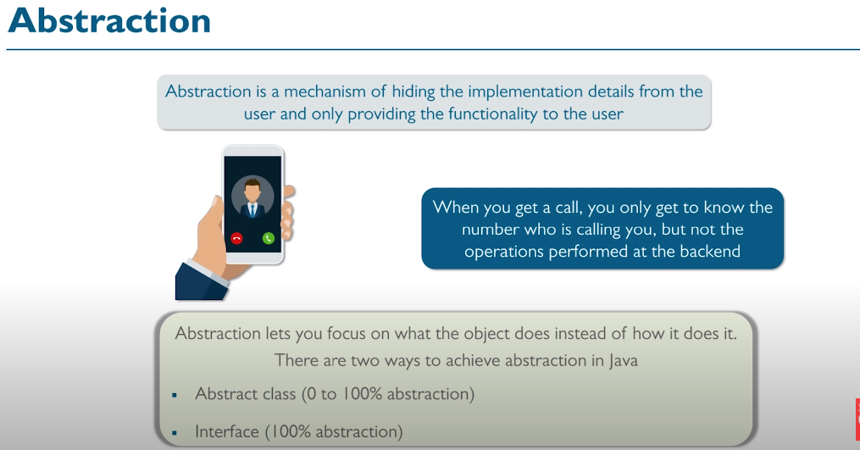
Abstract Class
A class which is declared using abstract keyword known as abstract class. An abstract class may or may not have abstract methods. We cannot create object of abstract class.
It is used to achieve abstraction but it does not provide 100% abstraction because it can have concrete methods.
An abstract class must be declared with an abstract keyword.
It can have abstract and non-abstract methods.
It cannot be instantiated.
It is used for abstraction.

Slide 58

Interface is a concept which is used to achieve abstraction in Java. This is the only way by which we can achieve full abstraction. Interfaces are syntactically similar to classes, but you cannot create instance of an Interface and their methods are declared without any body. It can have When you create an interface it defines what a class can do without saying anything about how the class will do it.
It can have only abstract methods and static fields.
However, from Java 8, interface can have default and static methods

Slide 59

Advantages of Interface
It Support multiple inheritance
It helps to achieve abstraction
It can be used to achieve loose coupling.

Slide 61
Exception handling in Java?
In general, an exception means a problem or an abnormal condition that stops a computer program from processing information in a normal way.
An exception in java is an object representing an error or an abnormal condition that occurs at runtime execution and interrupts (disrupts) the normal execution flow of the program.
An exception can be identified only at runtime, not at compile time. Therefore, it is also called runtime errors that are thrown as exceptions in Java. They occur while a program is running.

Slide 62

1. Suppose you are watching a video on Youtube, suddenly, internet connectivity is disconnected or not working. In this case, you are not able to continue watching the video on Youtube. This interruption is nothing but an exception.

Slide 63
2. Suppose a person is traveling by car from Mumbai to Pune. After traveling mid-distance, the tire of his car is punctured. This unexpected or unwanted event is nothing but an exception.
The car owner always keeps an extra tire as an alternative on a long-distance journey.
He changes the punctured tire by a new tire.
After changing the tire, he continues the rest of the journey.
This alternative way is called exception handling.

Slide 64

Types of Java Exceptions
There are mainly two types of exceptions: checked and unchecked.
Here, an error is considered as the unchecked exception.
According to Oracle, there are three types of exceptions:
Checked Exception
Unchecked Exception
Error

Slide 65
1) Checked Exception
The classes which directly inherit Throwable class except RuntimeException and Error are known as checked exceptions e.g. IOException, SQLException etc. Checked exceptions are checked at compile-time.
2) Unchecked Exception
The classes which inherit RuntimeException are known as unchecked exceptions e.g. ArithmeticException, NullPointerException, ArrayIndexOutOfBoundsException etc. Unchecked exceptions are not checked at compile-time, but they are checked at runtime.
3) Error
Error is irrecoverable e.g. OutOfMemoryError, VirtualMachineError, AssertionError etc.

Slide 66


Slide 67
Java provides five essential keywords to handle an exception.
They are:
try
catch
finally
throw
Throws
These keywords can be used to handle exceptions properly.

Slide 68
Try Block in Java
A keyword “try” is a block of code or statements that might throw an exception. That’s why a try block is also known as exception generated block.
The three possible forms of try block are as follows:
try-catch: A try block is always followed by one or more catch blocks.
try-finally: A try block followed by a finally block.
try-catch-finally: A try block followed by one or more catch blocks followed by a finally block.

Slide 69
Catch Block in Java
A keyword “catch” is a block of code that handles the exception thrown by the try block. That’s why it is also known as exception handler block. A catch block that catches an exception, must be followed by try block that generates an exception.
The general syntax of try-catch block (exception handling block) is as follows:
Syntax:
try
{
// A block of code; // generates an exception
}
catch(exception_class var)
{
// Code to be executed when an exception is thrown.
}

Slide 70


Slide 71

Rules of using Try and Catch block in Java
1. Java try-catch block must be within a method. 2. A try block can not be used without a catch or finally block. It must be followed by at least one catch block otherwise, the compilation error will occur. 3. A catch block must be followed by try block. There should not be any statement between the end of try block and the beginning of catch block. 4. A finally block cannot come before catch block.

Slide 72
Finally Block A “finally” is a keyword used to create a block of code that follows a try or catch block.
A finally block contains all the crucial codes such as closing connections, stream, etc that is always executed whether an exception occurs within a try block or not.
When finally block is attached with a try-catch block, it is always executed whether the catch block has handled the exception thrown by try block or not.

Slide 73
Syntax for try-catch-finally block:
try
{
statement1;
statement2;
}
catch(Exceptiontype e1)
{
statement3;
}
statement4;
finally
{
statement5;
}
Syntax for try-finally block:
try
{
statement1;
statement2;
}
finally // finally block
{
statement3;
}

Slide 74



Slide 75
class Test
{
static void avg()
{
try { throw new ArithmeticException("demo");
}
catch(ArithmeticException e)
{ System.out.println("Exception caught"); } }
public static void main(String args[])
{
avg();
}
}

Slide 76


Slide 77


Slide 78
Custom Exceptions:
class MyException extends Exception
{
private int ex;
MyException(int a)
{ ex = a; }
public String toString()
{ return "MyException[" + ex +"] is less than zero"; }
}
class Demo {
static void sum(int a,int b) throws MyException {
if(a<0) { throw new MyException(a); //calling constructor of user-defined exception class } else { System.out.println(a+b); } }
public static void main(String[] args)
{ try { sum(-10, 10); }
catch(MyException me)
{ System.out.println(me); //it calls the toString() method of user-defined Exception } } }

Slide 79
Collection Framework
A collection is a group of objects. In Java, these objects are called elements of the collection.
The Java Collections Framework is a collection of interfaces and classes which helps in storing and processing the data efficiently.
You can perform all operations such as searching, sorting, insertion, manipulation, deletion, etc., on Java collections just like you do it on data.
A Java collection framework includes the following:
Interfaces
Classes
Algorithm

Slide 80
Interfaces: Interface in Java refers to the abstract data types. They allow Java collections to be manipulated independently from the details of their representation
Classes: Classes in Java are the implementation of the collection interface. It basically refers to the data structures that are used again and again.
Algorithm: Algorithm refers to the methods which are used to perform operations such as searching and sorting, on objects that implement collection interfaces.

Slide 81

What is Collection in Java
A collection is a group of objects. In Java, these objects are called elements of the collection. Let’s understand it with some real time examples.

Slide 82
In childhood, you had a kiddy bank. In the kiddy bank, you had collected a lot of coins. This kiddy bank is called collection and the coins are nothing but objects.
2. During school time, you put all the important books in the school bag before going to school. Here Schoolbag is a collection and books are objects.
3. A classroom is a collection of students. So, the classroom is nothing but a collection and students are objects.
4. We know that the entire world is the collection of humans, animals, and different things. The world is a collection and humans, animals and different things are different objects.

Slide 83

Technically, a collection is an object or container which stores a group of other objects as a single unit or single entity. Therefore, it is also known as container object or collection object in java.
A container object means it contains other objects. In simple words, a collection is a container that stores multiple elements together.

Slide 84
Types of Objects Stored in Collection (Container) Object
There are two types of objects that can be stored in a collection or container object.
1. Homogeneous objects:
Homo means same. Homogeneous objects are a group of multiple objects that belong to the same class.
For example, suppose we have created three objects Student s1, Student s2, and Student s3 of the same class ‘Student’. Since these three objects belong to the same class that’s why they are called homogeneous objects.
2. Heterogeneous objects:Hetero means different. Heterogeneous objects are a group of different objects that belong to different classes.
For example, suppose we have created two different objects of different classes such as one object Student s1 and another one object Employee e1. Here, student and employee objects together are called a collection of heterogeneous objects.

Slide 85

Collection Hierarchy

Slide 86
Difference between Arrays & Collections in Java
1. Arrays are fixed in size but collections are growable in nature. We can increase or decrease size.
2. Arrays can store only homogeneous data elements (similar type of data) but collections can hold both homogeneous and heterogeneous elements.
3. Arrays do not support any method but collections support various kinds of methods.
4. Arrays can have both hold primitives and object types but collections can hold only objects but not primitive.

Slide 87
Collection Interface in Java
The basic interface of the collections framework is the Collection interface which is the root interface of all collections in the API (Application programming interface).
The Collection interface extends the Iterable interface. The iterable interface has only one method called iterator().
The function of the iterator method is to return the iterator object.
Using this iterator object, we can iterate over the elements of the collection.
List, Queue, and Set, have three component which extends the Collection interface. A map is not inherited by Collection interface.

Slide 88
List Interface
This interface represents a collection of elements whose elements are arranged sequentially ordered.
List maintains an order of elements means the order is retained in which we add elements, and the same sequence we will get while retrieving elements.
We can insert elements into the list at any location. The list allows storing duplicate elements in Java.
ArrayList, vector, and LinkedList are three concrete subclasses that implement the list interface.

Slide 89
Set Interface
This interface represents a collection of elements that contains unique elements. i.e, It is used to store the collection of unique elements.
Set interface does not maintain any order while storing elements and while retrieving, we may not get the same order as we put elements. All the elements in a set can be in any order.
Set does not allow any duplicate elements.
HashSet, LinkedHashSet, TreeSet classes implements the set interface and sorted interface extends a set interface.

Slide 90

Map Interface
Map interface is not inherited by the collection interface. It represents an object that stores and retrieves elements in the form of a Key/Value pairs and their location within the Map are determined by a Key.
Map uses a hashing technique for storing key-value pairs.
It doesn’t allow to store the duplicate keys but duplicate values are allowed.
HashMap, HashTable, LinkedHashMap, TreeMap classes implements Map interface.

Slide 91
Methods of Collection Interface
1. add(): This method is used to add or insert an element in the collection.
2. addAll(): This method adds a collection of elements to the collection.
3. clear(): This method clears or removes all the elements from the collection.
4. contains(): It checks that element is present or not in a collection.
5. isEmpty(): It returns true if a collection is empty.
6. remove(): It removes a specified element from the collection.
7. size(): The size() method returns the total number of elements in the collection

Slide 92

Array list: ArrayList is the implementation of List Interface where the elements can be dynamically added or removed from the list. Also, the size of the list is increased dynamically if the elements are added more than the initial size.

Slide 93

Linked List: Linked List is a sequence of links which contains items. Each link contains a connection to another link.
Java Linked List class uses two types of Linked list to store the elements:
Singly Linked List
Doubly Linked List
Singly Linked List: In a singly Linked list each node in this list stores the data of the node and a pointer or reference to the next node in the list.

Slide 94

Doubly Linked List: In a doubly Linked list, it has two references, one to the next node and another to previous node.

Slide 95

Java Collections: Sets
A Set refers to a collection that cannot contain duplicate elements.
It is mainly used to model the mathematical set abstraction.
Set has its implementation in various classes such as HashSet, TreeSetand LinkedHashSet.

Slide 96

Map Interface
In Java, elements of Map are stored in key/value pairs. Keys are unique values associated with individual Values.
A map cannot contain duplicate keys. And, each key is associated with a single value.

Slide 98


Slide 99


Slide 100


Slide 101

NoSQL database examples
include
MongoDB,
BigTable,
Redis,
Cassandra,
HBase,
Neo4j, and CouchDB

Slide 102


Slide 103


Slide 104


Slide 105


Slide 106


Slide 107


Slide 108


Slide 109


Slide 110


Slide 111


Slide 112


Slide 113


Slide 118


Slide 120


Slide 121


Slide 122


Slide 123


Slide 124


Slide 125


Slide 126


Slide 127


Slide 128


Slide 129


Slide 130


Slide 131


Slide 133


Slide 134


Slide 135


Slide 136


Slide 137


Slide 138


Slide 139


Slide 140


Slide 141


Slide 142


Slide 143


Slide 144


Slide 145


Slide 146


Slide 147


Slide 149


Slide 151
Connect MongoDB With Express.js App | MERN Stack CRUD Application Series - #2 (youtube.com)

